Slide 1
Task 1:-Iris Flower Classification
Name:-Bushra Akram Salmani
Oasis Infobyte intership

Slide 2
Iris dataset = 150 flower samples
3 species:
- Setosa
- Versicolor
- Virginica
Features:
- Sepal length
- Sepal width
- Petal length
- Petal width

Slide 3
1. Dataset load kiya
2. Data split kiya (80% train, 20% test)
3. Logistic Regression model banaya
4. Model train kiya
5. Accuracy check ki

Slide 4
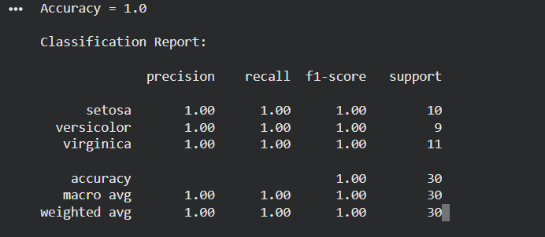

Slide 5
